Slide 1
Fruit Eater Game

Slide 2
Agenda
Topics
Presenter(s) for milestone3
2. Screenshots of source code, UI Widgets
3. Final Simulator result
4. 3+ knowledge points from the class
5. Additional bonus points knowledge
6. Live demo of project in simulator and iPhone

Slide 3
Presenter(s) for milestone3
Names | Id
Supriya Deore | 19299
2. Shrimukhi Kasula | 16420
3. Pawan Kumar Levanth | 18727
4. Shruti Gopissetty | 19152
5. Shahnoor Mozzam | 19147

Slide 4
Screenshots of source code, UI Widgets
ItemController.swift

Slide 5
Player.swift

Slide 6
MainMenuScene.swift

Slide 7
Gameplay
Scene.swift

Slide 8
UI Widgets
MainMenu.sks
Color Sprite for button

Slide 9
Label
GamePlay
Scene.swift
Color Sprite for Bgr
Color Sprite for palyer

Slide 11
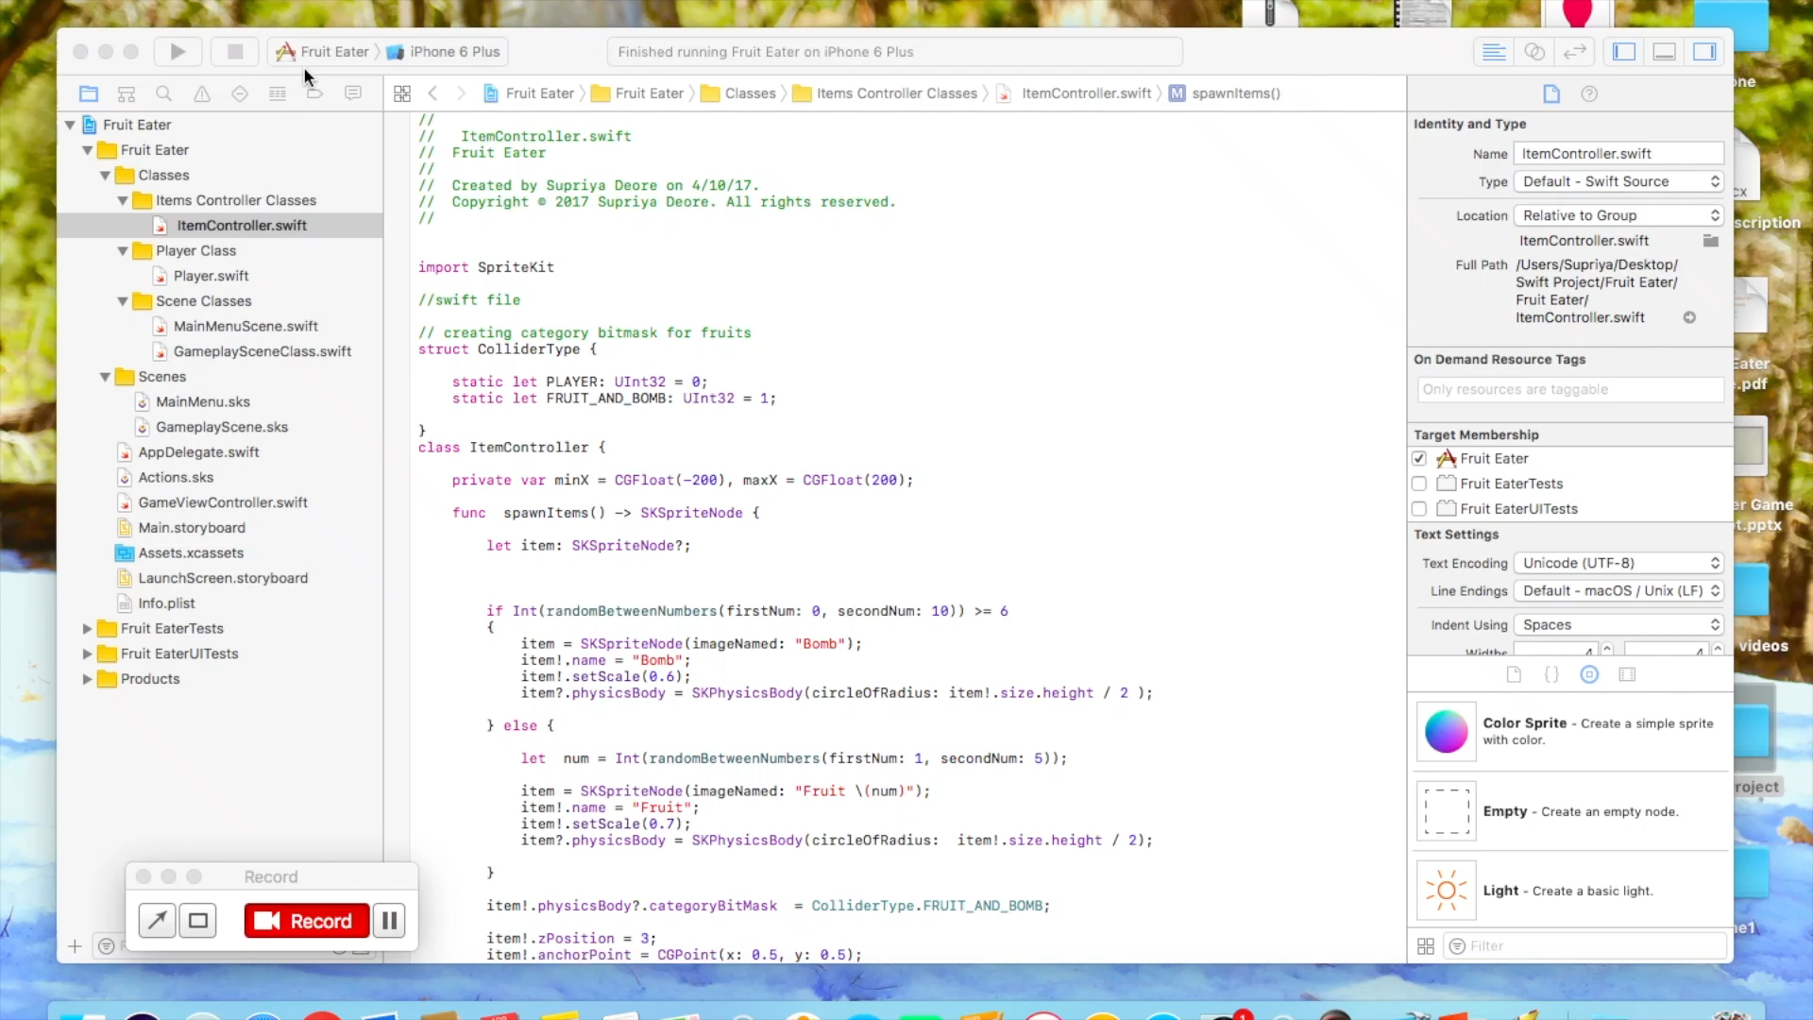
Final Simulator result (Click on the snapshot below to play video in presentation mode.)

Slide 12
3+ knowledge points from the class
Button Control, Labels, Image View, Textbox
Touch, Tap, Gesture
Multi-view Applications (multiple pages)
Adaptive Design
Game

Slide 13
Additional bonus point knowledge
Color sprite
SKPhysicsContactDelegate
Affected By gravity
ISDynamic
SKScene
Sprite kit framework
Create Class in swift file
Use of Constructor
Created user define functions

Slide 14
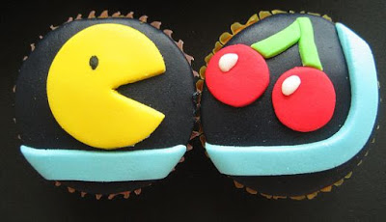
Thank You !!!!!!!!!!!
Thank You !!!!!!!

